Slide 1

SAP BTP ABAP on Cloud / RAP Training
DAY-2
Anubhav Oberoy
www.AnubhavTrainings.com
Follow excellence with sheer passion

Slide 2


DISCLAIMER
The training content and delivery of this presentation is confidential, and cannot be recorded, or copied and distributed to any third party, without the written consent of Anubhav Trainings

Slide 3
Agenda
01
ABAP on Cloud
02
Use case
03
First AOC program
04
Create Table
www.anubhavtrainings.com

Slide 4

ABAP on Cloud – the environment
ABAP on cloud is an ABAP environment running on SAP BTP on top of AWS infrastructure. It is a shared ABAP system in trial mode.
Since it’s a shared system with other abap trial users, we will see all the packages of other users as well.
With ABAP on Cloud, NO ONE EVER-EVER access SAPGUI, No Tcodes are allowed with GUI. In fact, you cant event use SAPGUI to connect to ABAP on Cloud system
We don’t have control to install notes, patches, and upgrade
No access to SPRO (customizing) is allowed in the cloud
ABAP on Cloud is just abap environment, its not a SAP Solution (like s/4hana or ecc), so you will never find standard sap tables like MARA, VBAK, ACDOCA, MATDOC etc.
You are only allowed to use DDIC objects which are marked released
We cannot create everything like what we do in a on-premise system e.g. forms, workflow, scripts, dialog prog.
We cannot create ABAP programs in the AoC system, all code will be in-form of classes.
The AoC only allows whitelisted ABAP statements, no other abap statements can be used freely e.g. write.
https://help.sap.com/docs/sap-btp-abap-environment?locale=en-US
You can create your packages under a standard package ZLOCAL
The preferred programming model to develop applications is RAP – Restful Application Programming model
ABAP in Cloud has a code name called “steampunk”
www.anubhavtrainings.com

Slide 5









Use cases 1 – Building Full Stack Application
www.anubhavtrainings.com

Slide 6
























Use Case 2 – Side by Side Extension
www.anubhavtrainings.com

Slide 7



Use Case 3 – S/4HANA Cloud Extension
S – Simplification 4 – 4th Generation ERP
S/4HANA – Onpremise, Cloud
www.anubhavtrainings.com

Slide 8








Slide 9
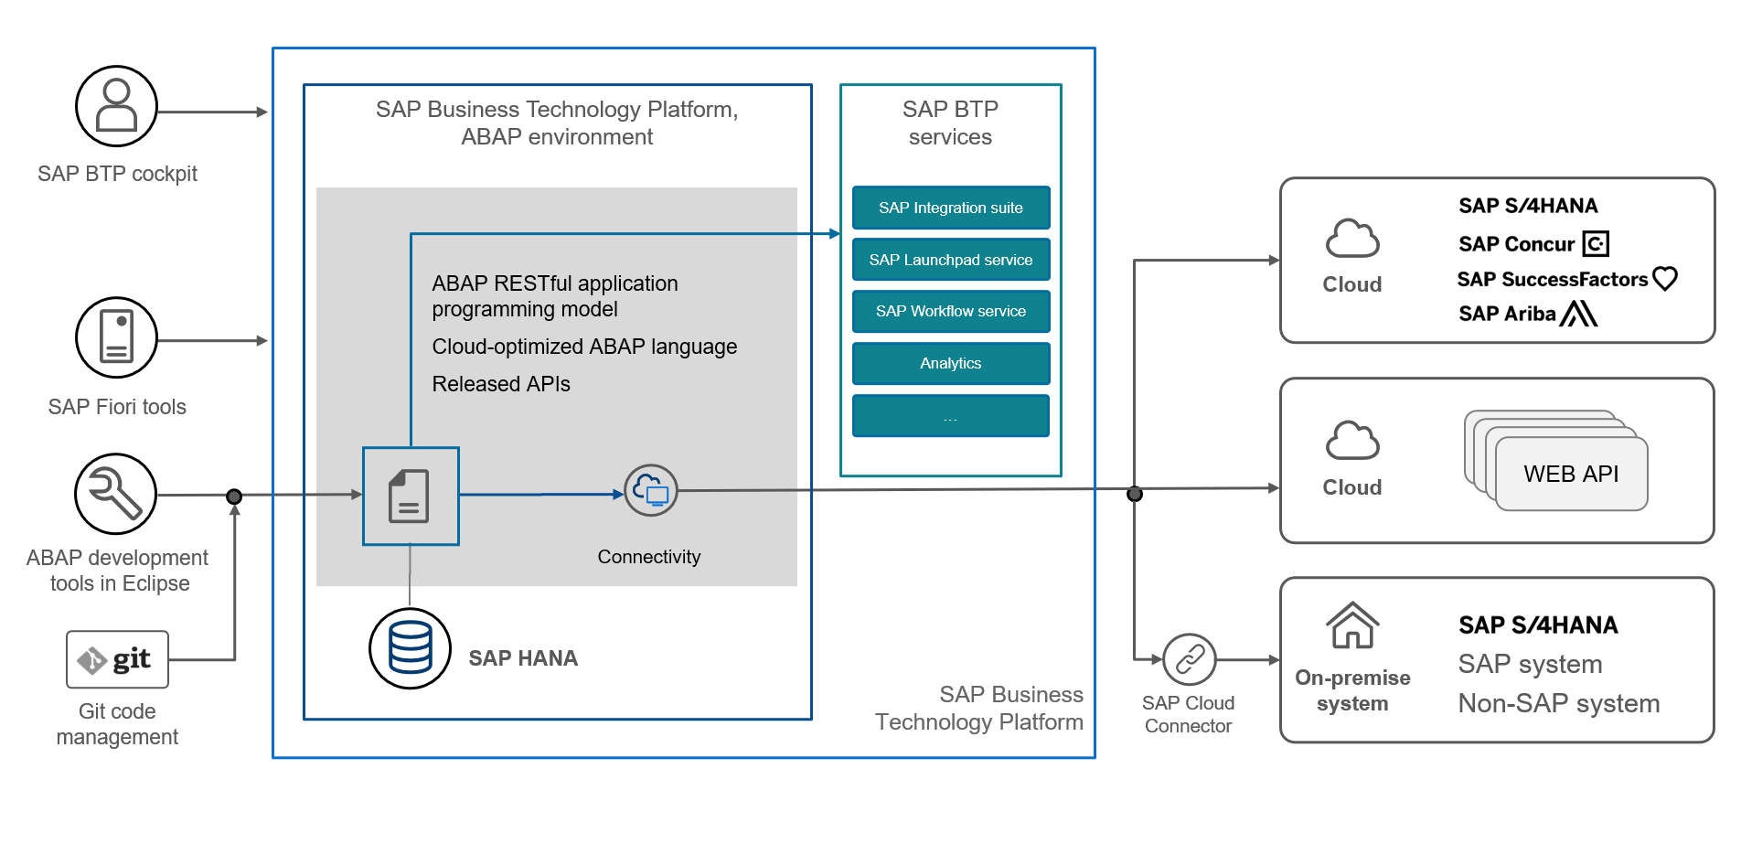
Vital parts of SAP BTP ABAP Enviornment
www.anubhavtrainings.com

Slide 10
CDS – Core Data & Services
CDS is the new approach of building semantically rich data models. It is an extension of SQL in ABAP world.
What has been extended?
DDL – Data definition language – design new data models – new tables, structures
DQL – Data Query Language (CDS Views and CDS Entities) – new views to extract data (agg., join, load, calculate,formulas)
DEL – Data Expression language (expressions like path expression, case expressions)
DCL – Data Control Language (security)
Since in ABAP on Cloud Environment we do not have GUI access (no access to SE11) – we will use CDS
Naming convention – is a best practice to follow in a project. ZCOMPANY_PROJ_OBJTTP_NAME
ZATS_XX_*
We will use an uploader utility provided by SAP, get this in our ABAP on Cloud System to test it
Install the abap git plugin so we can interact with github from our adt tool - http://eclipse.abapgit.org/updatesite/
Download the code from SAP standard repository - https://github.com/SAP-samples/abap-file-uploader
Register a service
Run the utility
www.anubhavtrainings.com

Slide 11
JSON – Java Script Object Notation
It is a light weight data format to transmit data from one system (peer) to another system.
{
“prop”: val,
“prop”: val,
“prop”: val,
“prop”: val,
…
}
{
“empStr”: { “empId”:1001,
“empName”:”Anubhav”,
“salary”: 5000
},
“empTab”: [ {“empId”:1001,
“empName”:”Anubhav”,
“salary”: 5000
} , {“empId”:1001,
“empName”:”Anubhav”,
“salary”: 5000
} , {“empId”:1001,
“empName”:”Anubhav”,
“salary”: 5000
}
]
}
gitHUB
Repository of code
ADT
Abap git plugin
AOC (BTP)
www.anubhavtrainings.com

Slide 12
















DB Design
Suppose you are working on a company which has recently opt for Rise with SAP and bought a subscription of BTP with ABAP on cloud environment. You do not have an on-premise system, and you have many SAP ABAP consultants in the team. You want to build end to end software in cloud for your customer. We always starts with DB Tables.
www.anubhavtrainings.com

Slide 13



























Slide 14

What We Did
Let’s Summarize
www.anubhavtrainings.com

Slide 15
www.anubhavtrainings.com
Thank You
End of Day 1
www.anubhavtrainings.com

Slide 16


We’re committed to empower you to be
#FutureReady
through powerful training solutions.
We build the workforce of the future.
250+
Corporate Clients
30,000+
Learners Trained
25000+
Learners Placed
FREE WEBINARS
Sign up for free webinars with industry experts every fortnight!
Enroll Now!
Contact us today!
https://anubhavtrainings.com

